Slide 1
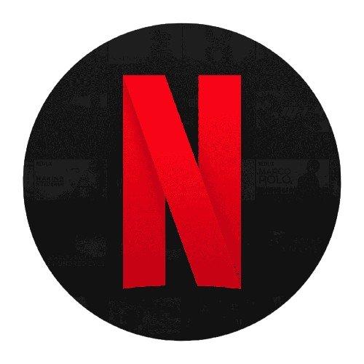
MAJOR PROJECT NETFLIX CLONE

Slide 2
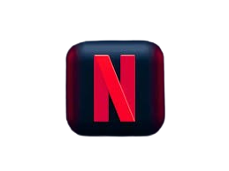
Table of contents
01
02
03
04
05
06
Introduction
Objectives
Project Features and Implementation
Technical Challenges
Future Improvements
Summary

Slide 3
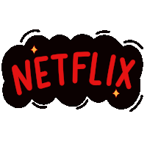
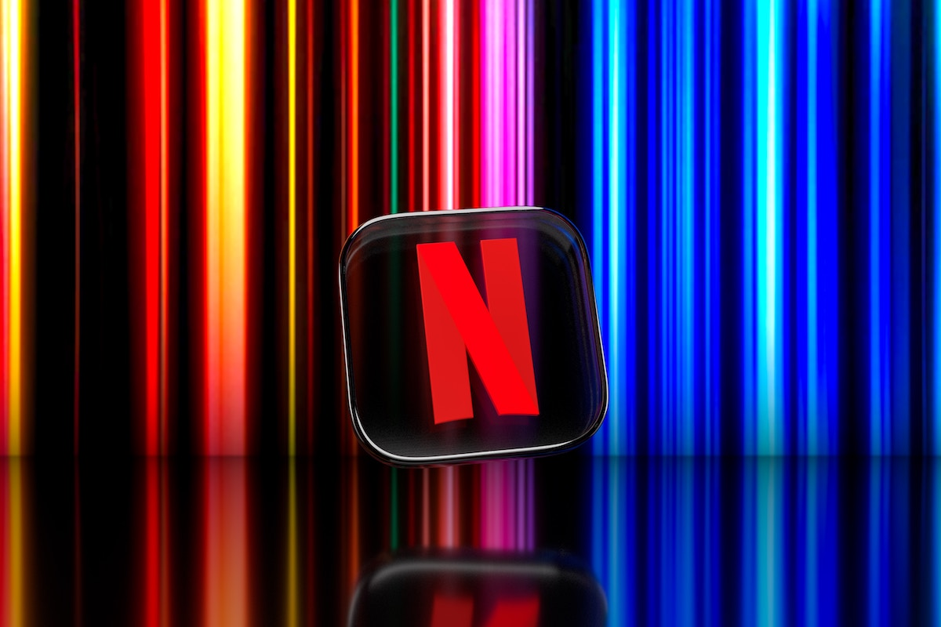
What is NETFLIX CLONE?
A Netflix Clone is a web application designed to replicate the look, feel, and core functionalities of Netflix, one of the world’s most popular streaming platforms
Key Features of a Netflix Clone :
User Interface (UI)
Responsive Layout
User Authentication
API Integration
The goal of the Netflix Clone project is to replicate Netflix's user interface and functionality while practicing front-end web development skills. It aims to create a responsive, interactive application .

Slide 4
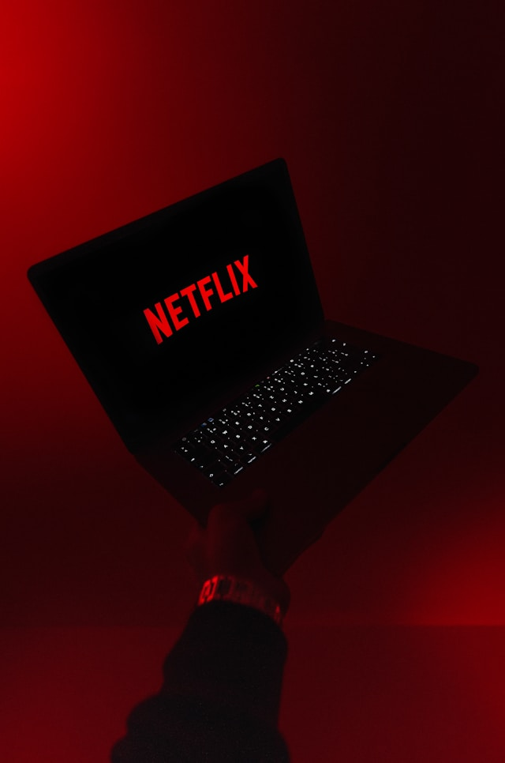
01
Introduction

Slide 5

Introduction
PROJECT IDEA
The Netflix Clone project is a web-based application designed to replicate the core user interface and functionality of the popular streaming platform, Netflix. Developed as a major project for the Meta SciFor training program, this clone leverages front-end web development technologies to deliver a visually engaging and responsive user experience. The project demonstrates fundamental skills in HTML, CSS, JavaScript, Bootstrap, and jQuery, while providing a solid foundation for future dynamic data integration through APIs.

Slide 6
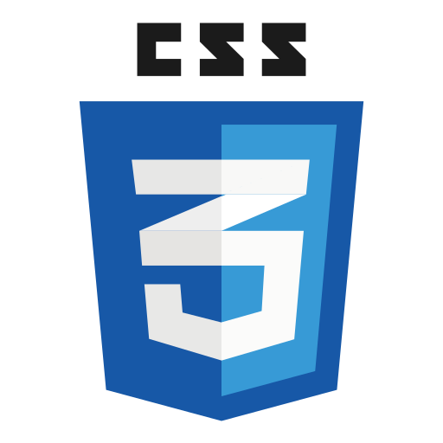





Technologies Used
HTML
CSS
JAVASCRIPT
For structuring the webpage and organizing content.
To style and enhance the visual layout, ensuring a polished look.
For adding interactivity and dynamic functionality.
BOOTSTRAP
JQUERY
Git and GitHub
To simplify responsive design and streamline the layout.
Used for creating the carousel and handling DOM manipulation efficiently.
For version control, tracking progress, and managing project code.

Slide 7
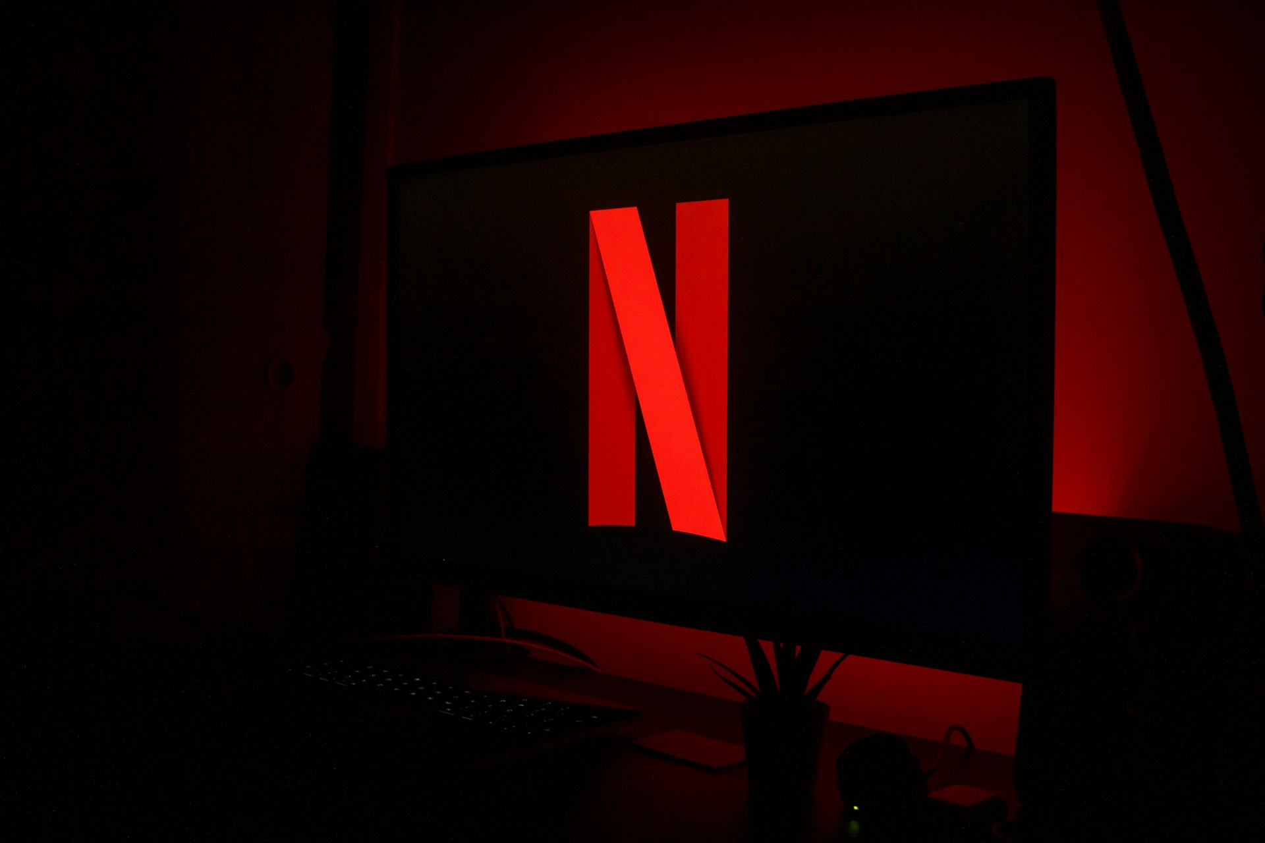

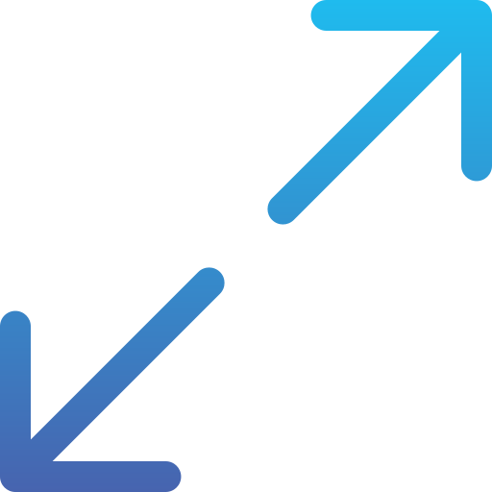

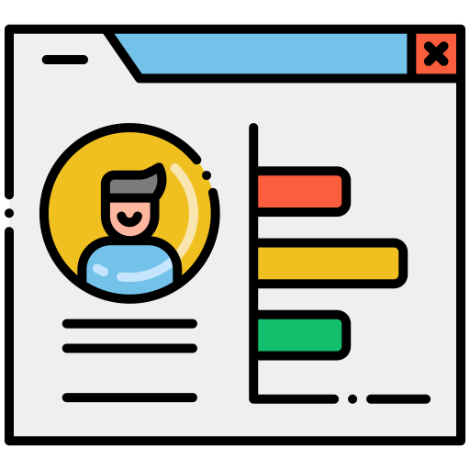
Objectives of the Netflix Clone
Easy Expandability
Replicate Netflix's UI/UX
Recreate the layout and functionality of Netflix to simulate a familiar streaming platform experience.
Utilize technology and customer feedback to come up with novel solutions that meet your customer’s demands or needs
Showcase a Portfolio-Worthy Project
Build a Responsive Web Application
Ensure the website is fully responsive and adapts seamlessly across various devices (desktop, tablet, mobile).
Identify times of year when demand for certain products may spike, such as holidays or special occasions, and use these times to target customers or maximize sales

Slide 8
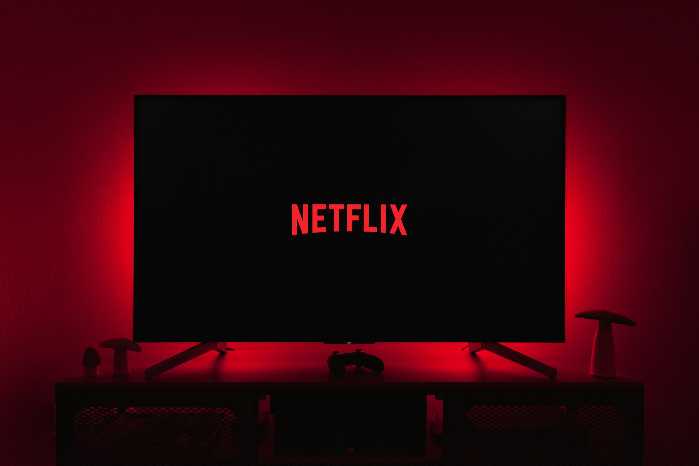

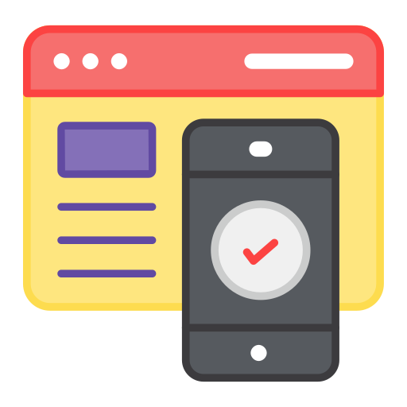

Key Features of the Netflix Clone
Dynamic Content Carousels
Responsive Design
Hero Section with Video Playback
A great presentation for a pitch deck should be concise, clear and easy to understand. Visual elements such as charts, graphs, images, and videos can help to make the presentation engaging
When it comes to picking investors for a pitch deck, it's important to research potential investors and understand their preferences, goals
and interests
The value of a product is determined by how much customers are willing to pay for it. It's a combination of factors, including the quality of the product, its features, and how well it meets customer needs

Slide 9
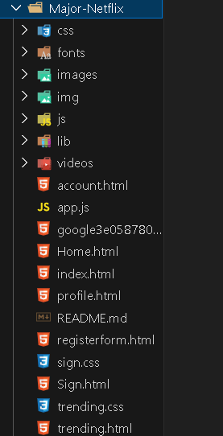
Implementation and Results
Folder Structure Breakdown:-
1. css : Contains all the CSS files that style the different components and pages of the website.
Example files: sign.css, trending.css which likely contain styling for the sign-in page and trending section, respectively.
2. fonts/ : Holds font files used in the project to ensure consistent typography across the website. This include custom fonts or web fonts required for the Netflix-style look.
3. images/ : Contains all image assets, such as logos, icons, and thumbnails, used throughout the website.
4. lib/ : Contains external libraries or dependencies used in the project, such as jQuery, Owl Carousel, or other plugins.

Slide 10
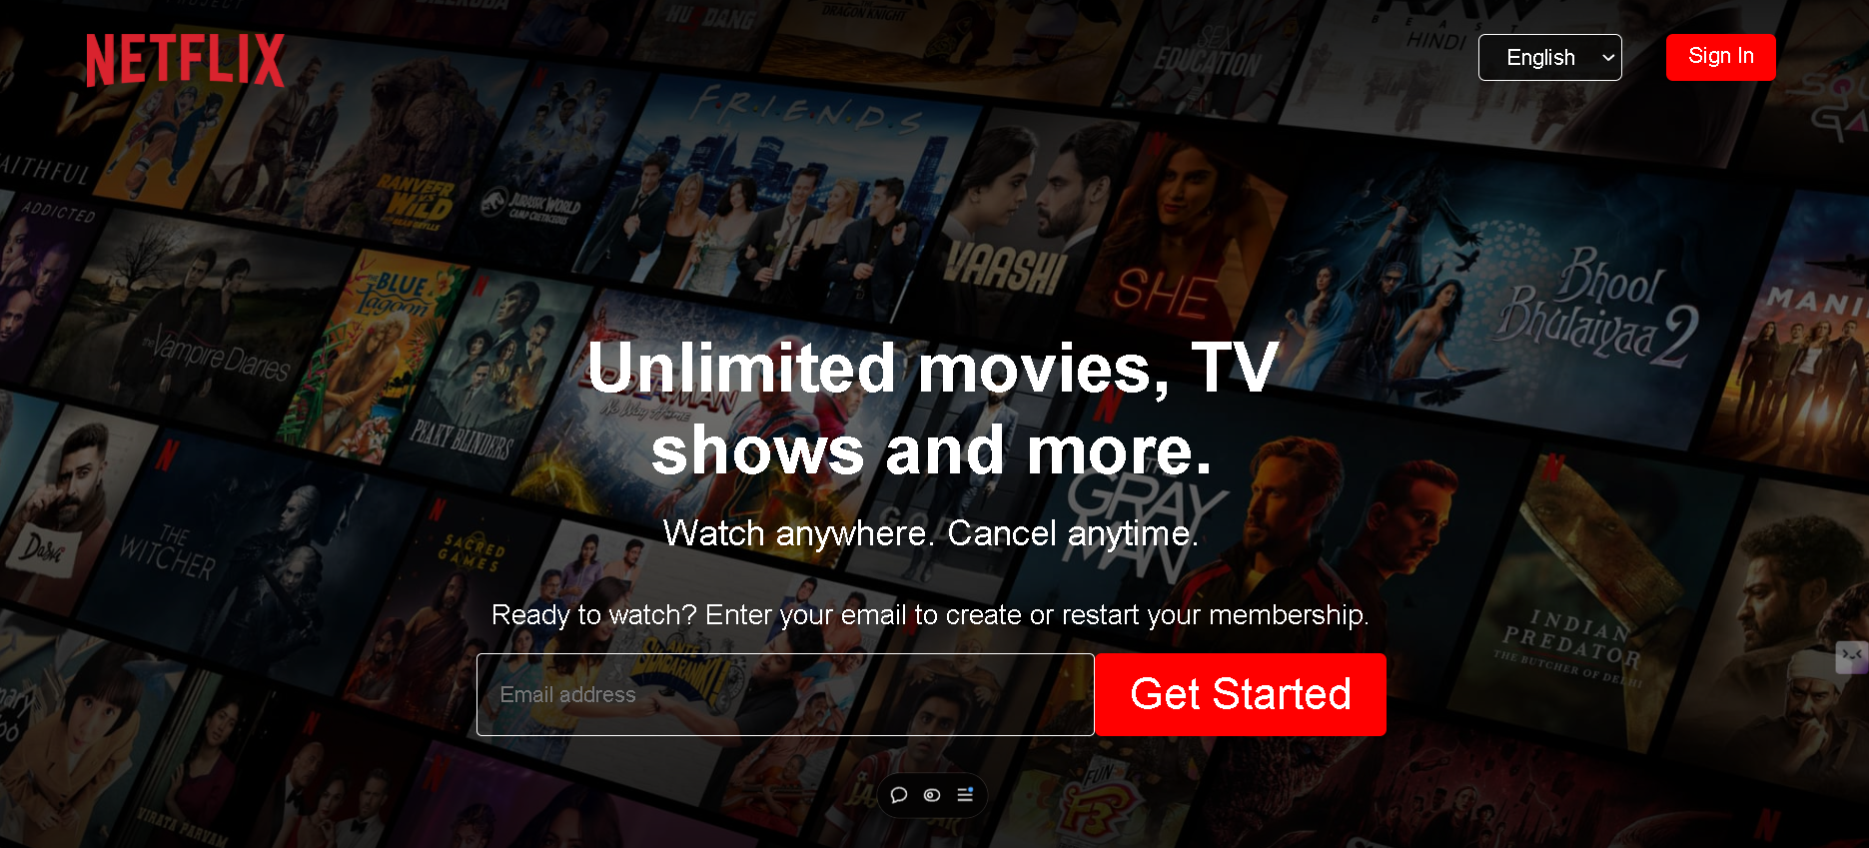
Landing Page: The homepage of the Netflix Clone serves as the central hub for showcasing popular content and providing new users with information about Netflix’s plans, features, and frequently asked questions (FAQ). This section aims to engage both potential subscribers and returning users by highlighting the core benefits of the platform, available subscription plans, and answers to common questions.

Slide 11
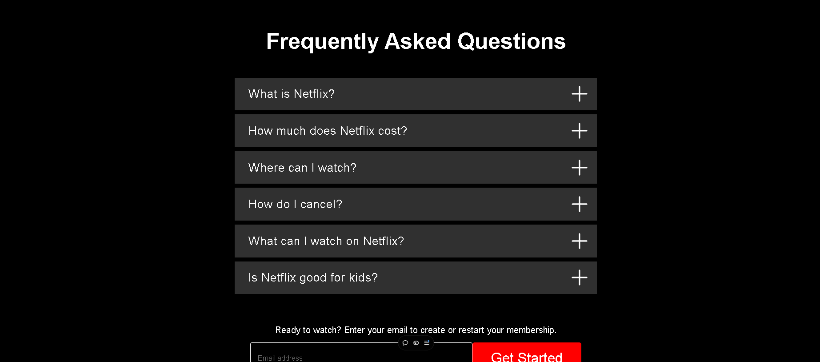

Slide 12
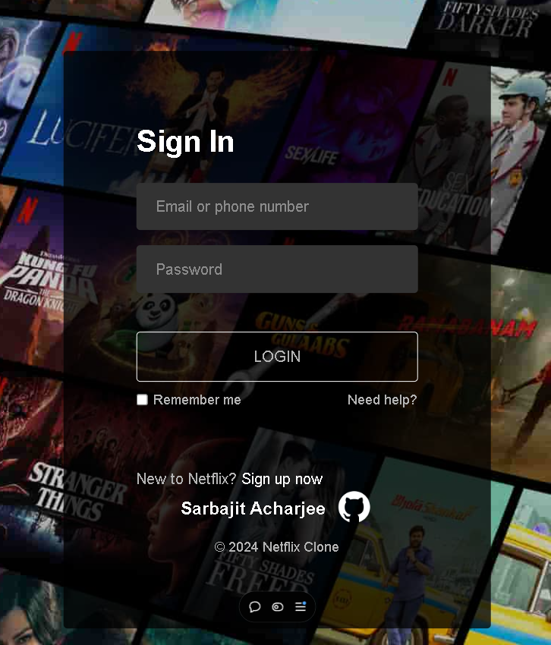
Sign In Form
The Sign-In Page of the Netflix Clone is designed to provide users with a secure and straightforward way to log into their accounts. This page has a minimalistic, user-friendly interface that closely resembles Netflix’s original sign-in page, focusing on simplicity and accessibility.

Slide 13
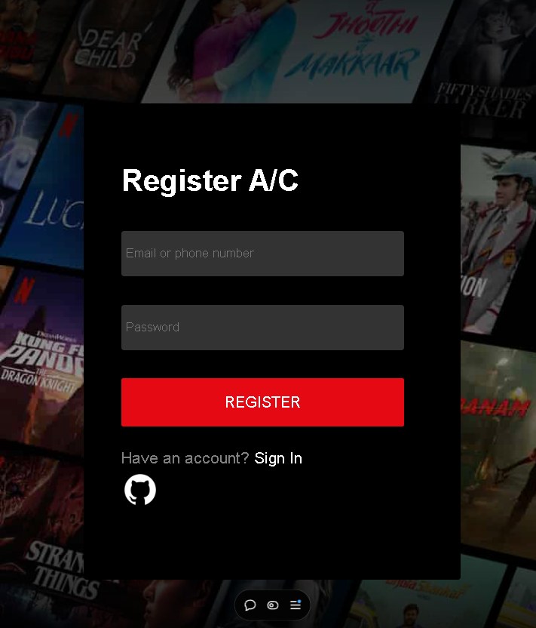
Register Form
The Sign-Up (Register) Page of the Netflix Clone is designed to guide new users through the account creation process smoothly and intuitively.

Slide 14
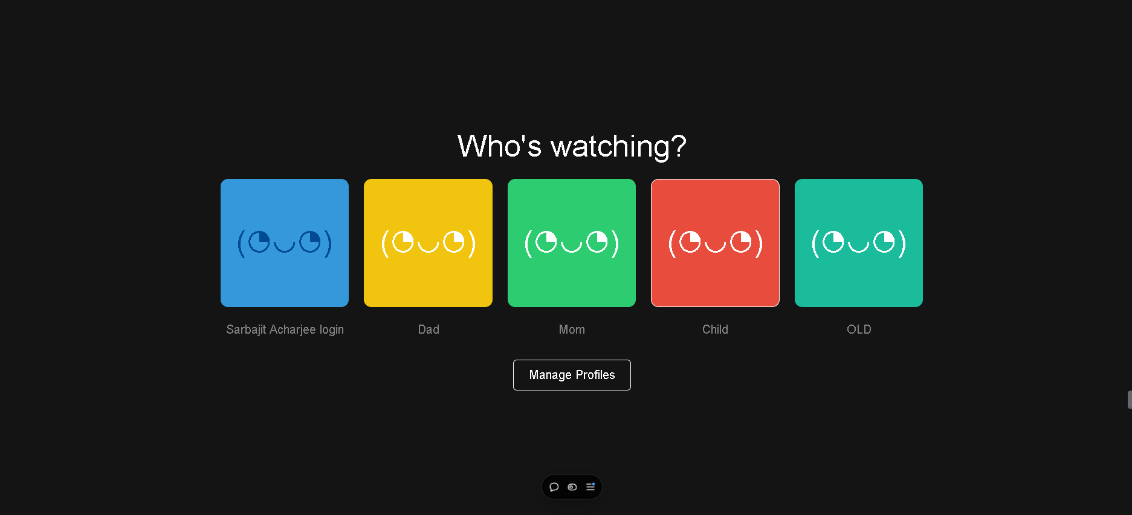
The Profile Section of the Netflix Clone allows users to manage their profiles, customize their viewing preferences, and access personalized content. This section is essential for a multi-user experience, where different family members or individuals can have separate profiles on the same account, each with its own recommendations and watch history.

Slide 15
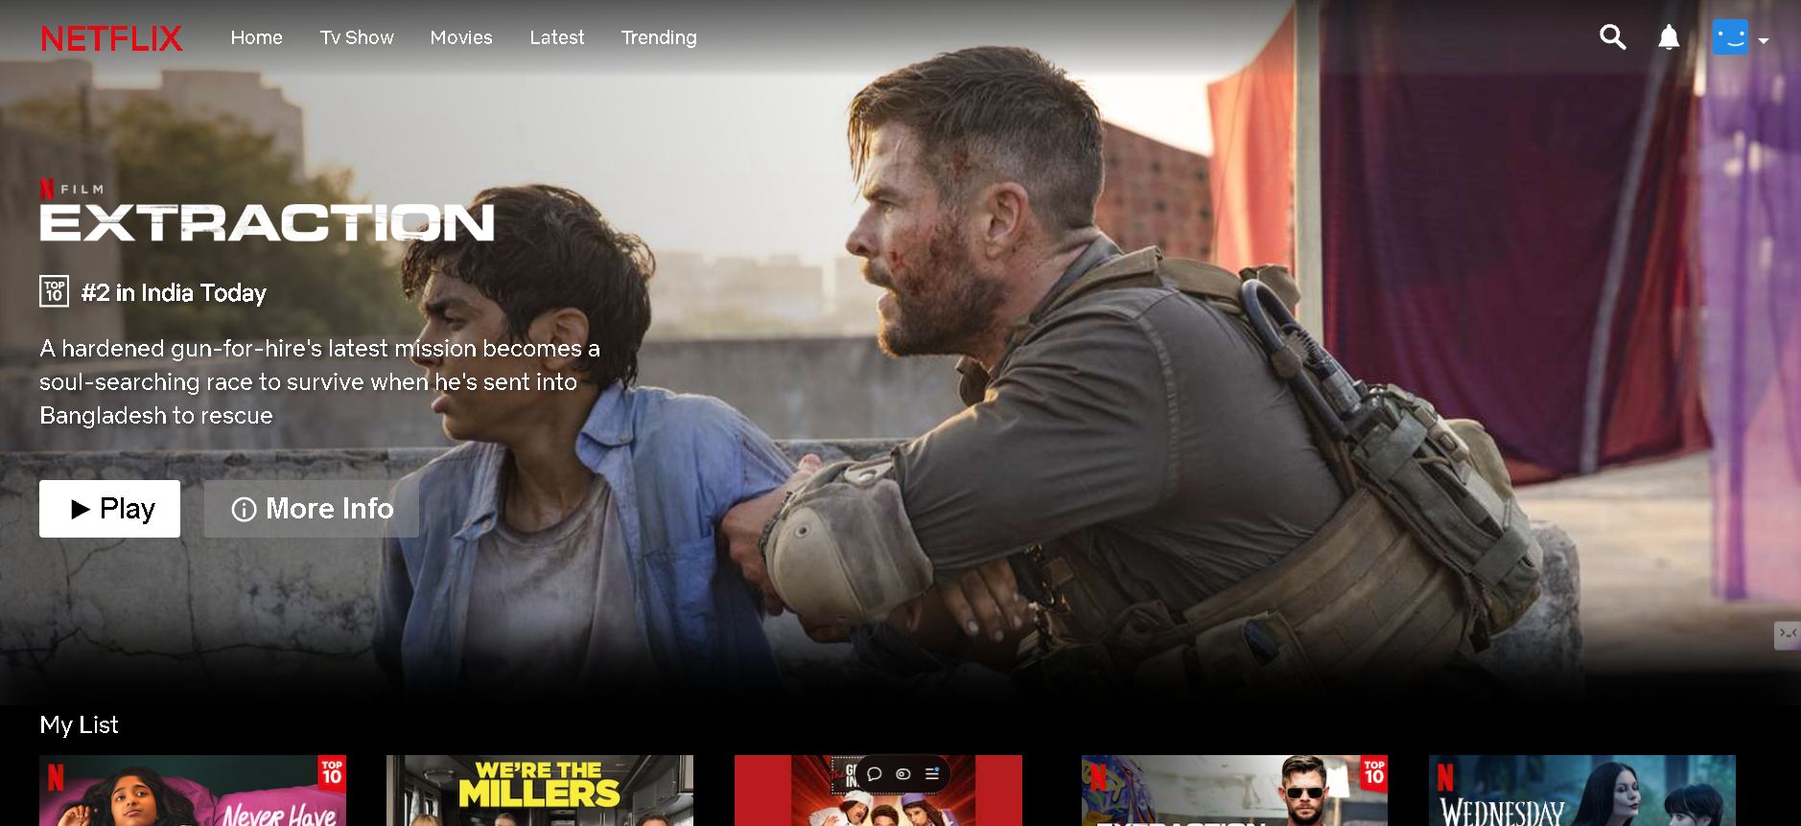
The Netflix hero page, often referred to as the "landing page," serves as the first impression for users visiting the Netflix website or app. It plays a crucial role in engaging visitors and encouraging them to explore the platform's extensive content library. Here are the key features and design elements that define the Netflix hero page

Slide 16
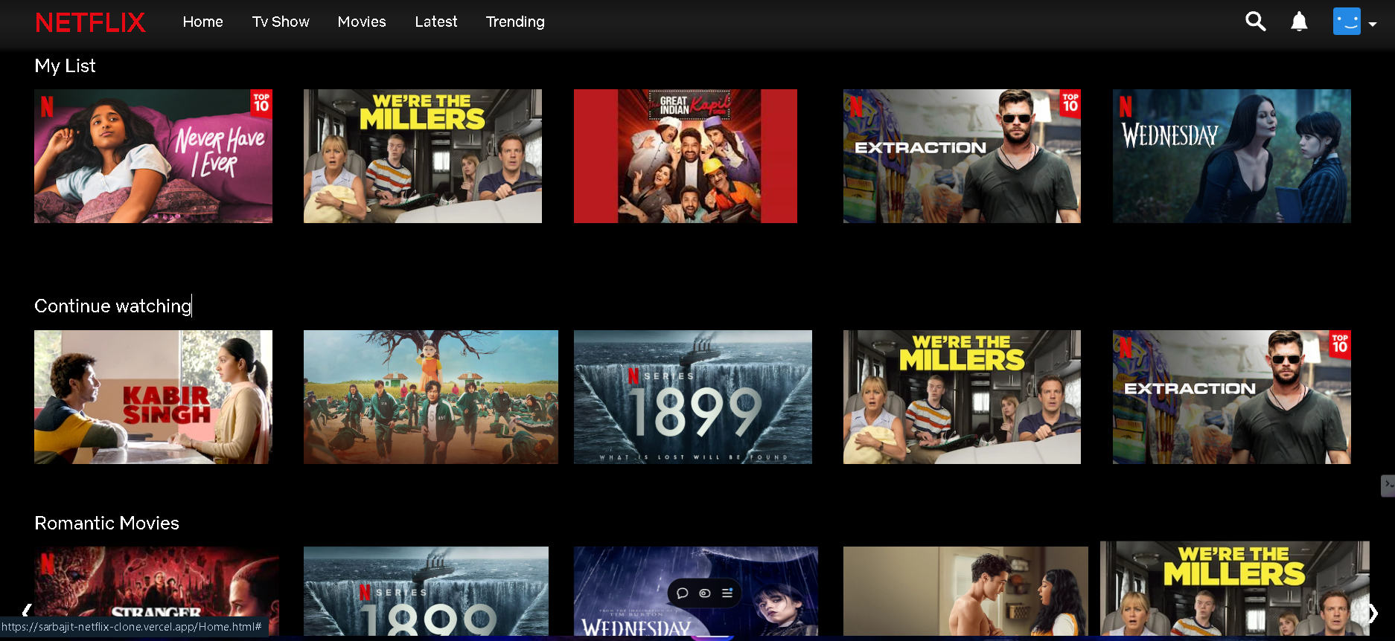
Genre Section : The genre sections on the Netflix hero page help users navigate through the vast array of content available, catering to diverse tastes and preferences.

Slide 17
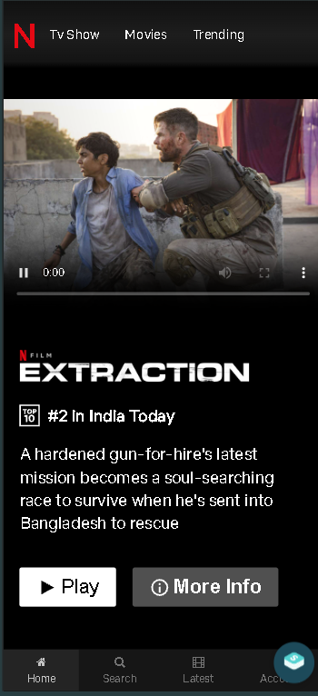
RESPONSIVE DESIGN
Creating a responsive Netflix clone website involves ensuring that the layout and elements adapt seamlessly to various screen sizes, including mobile phones, tablets, and laptops/PCs. Below, I’ll outline key strategies, best practices, and example code snippets for making a Netflix clone responsive across different devices.

Slide 18
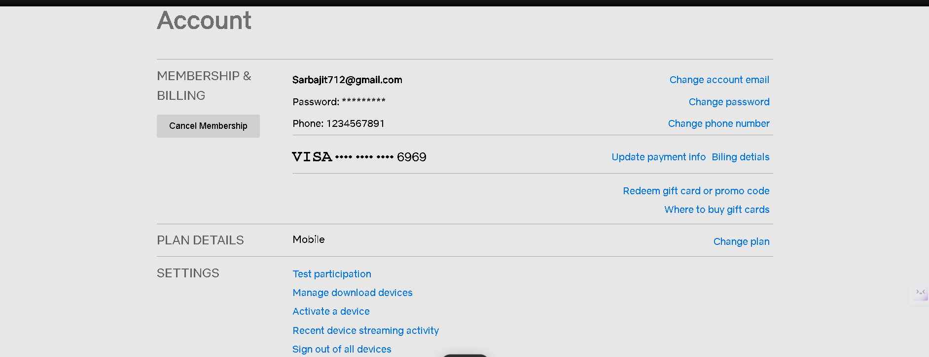
The account section on Netflix is a crucial component of the user experience, allowing subscribers to manage their profiles, settings, and preferences. This section is designed to provide users with control over their Netflix account while ensuring a personalized viewing experience. Here’s a detailed overview of the key features and functionalities typically found in the account section:

Slide 19
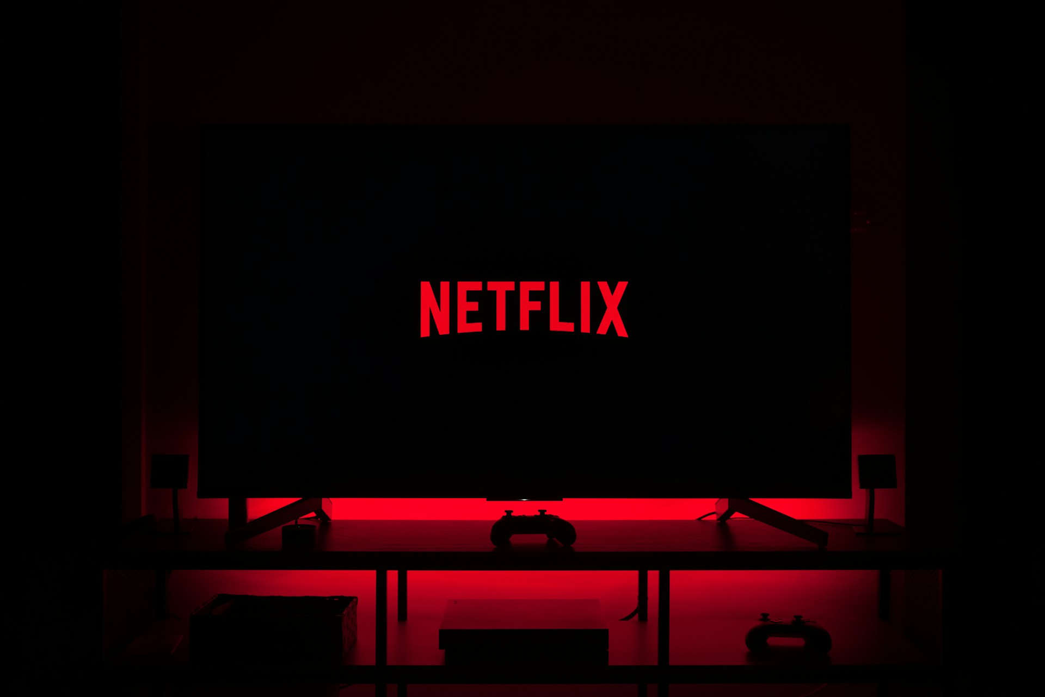
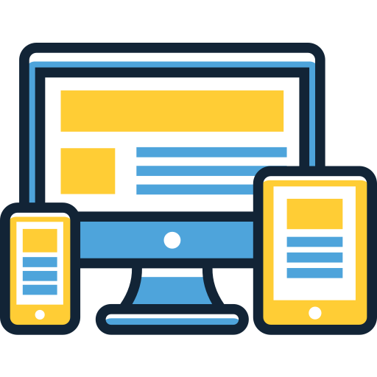
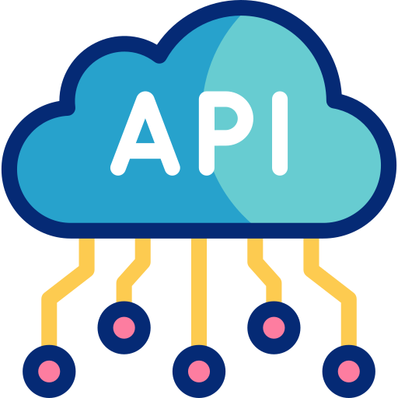

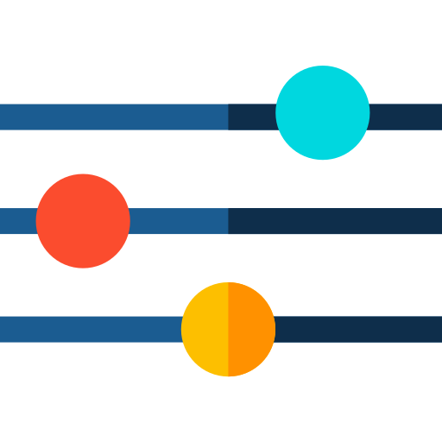
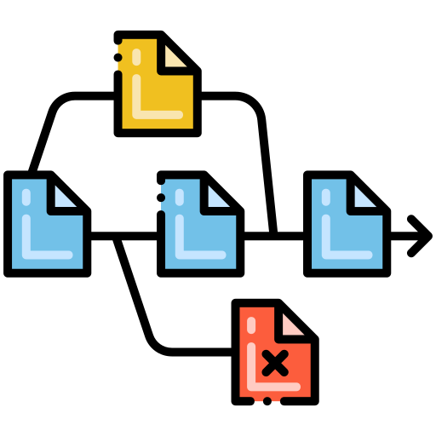

Six Problems Faced
API Limitations
Responsive Design Challenges
Video Playback Responsiveness
Ensuring the layout adapted smoothly across various screen sizes required careful tweaking of CSS,
The TMDB API, initially planned for real-time movie data, was banned in India.. Have to work with normal Images and videos
Making the hero section video responsive on mobile while keeping it visually appealing on larger screens required extensive testing and adjustments.
Dynamic Carousel Implementation
Version Control
Navigation Bar Dropdown Issues
Setting up the jQuery carousel to display different categories effectively was challenging, requiring precise control over animations and user interactions.
Managing multiple updates using Git and GitHub was a learning curve, but it provided valuable experience in tracking changes and organizing project files.
Integrating a dropdown menu into the navigation bar while maintaining a clean layout and accessibility proved difficult, especially on smaller screens.

Slide 20
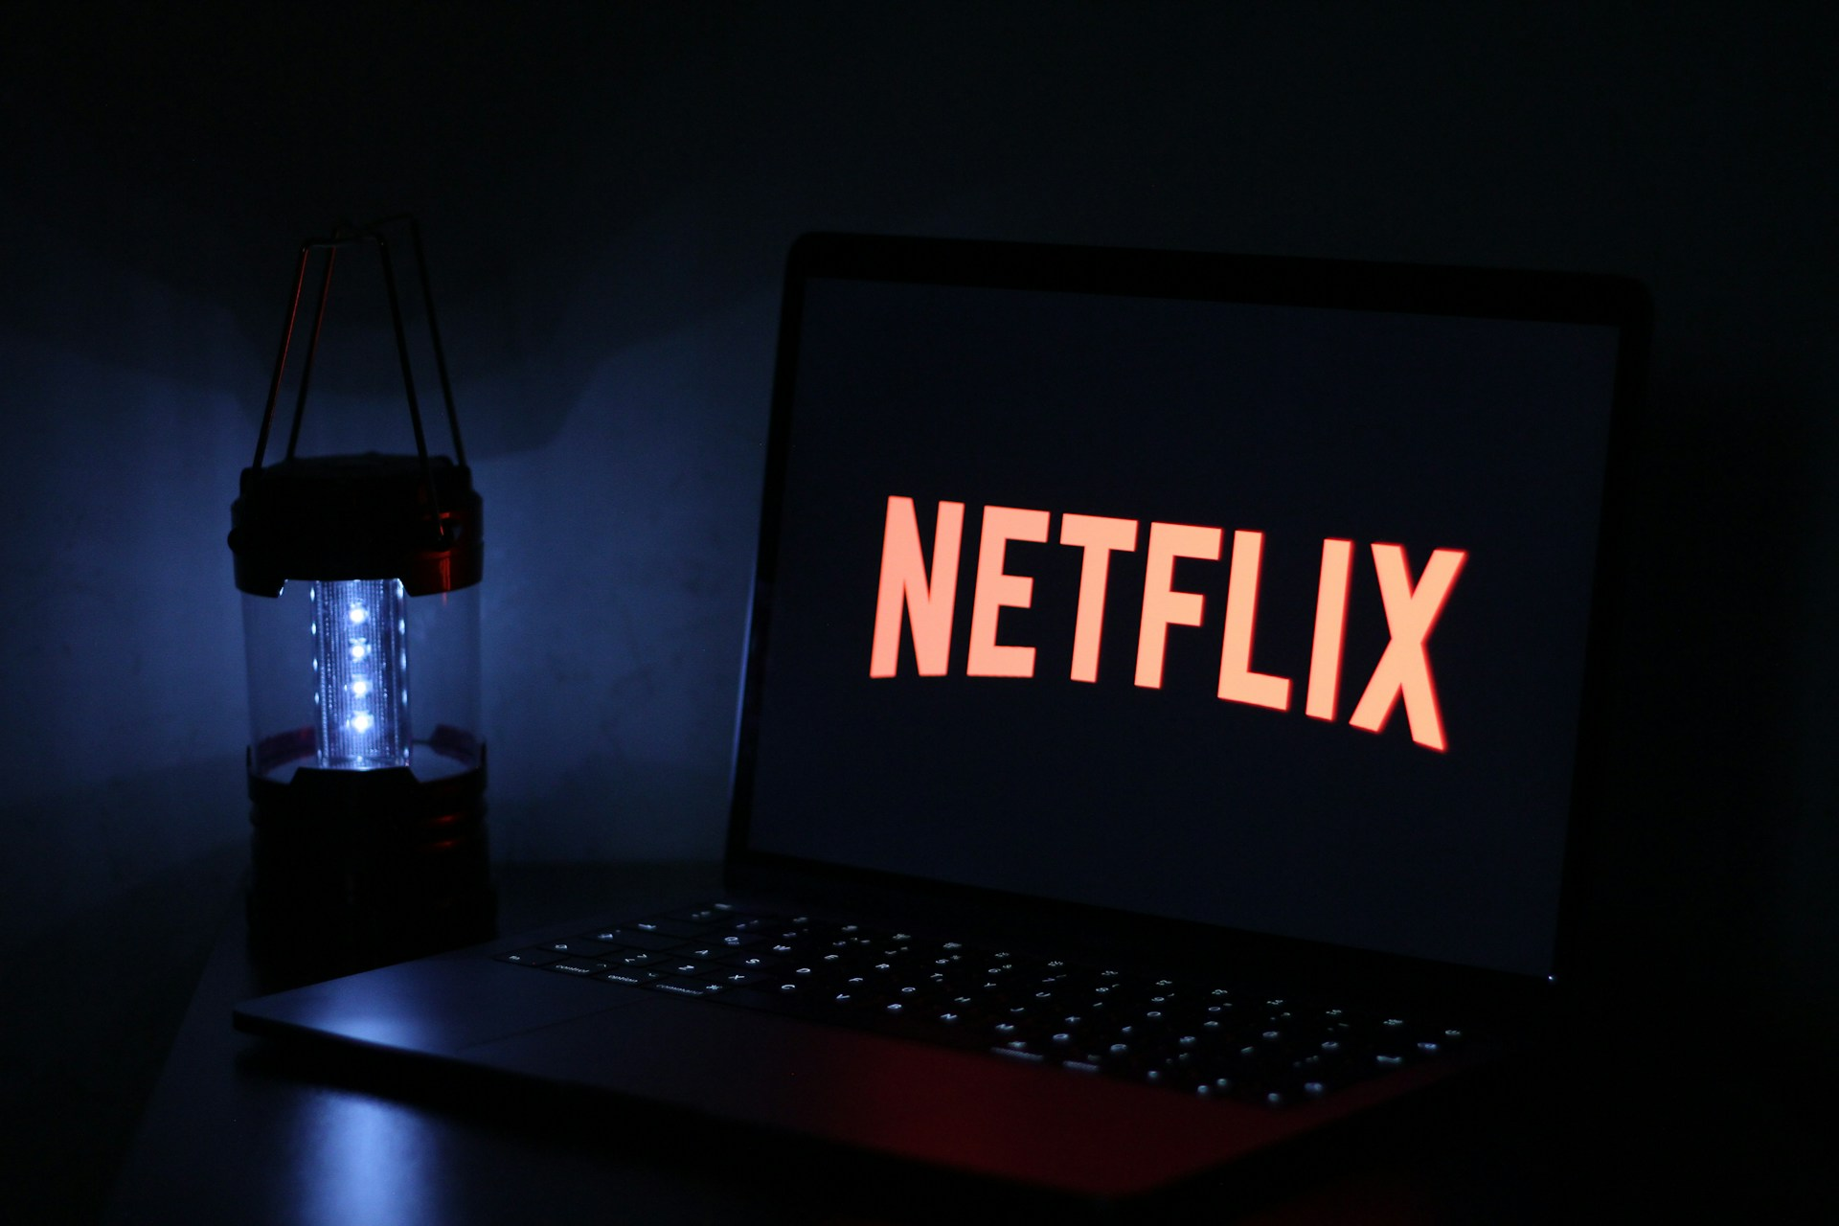
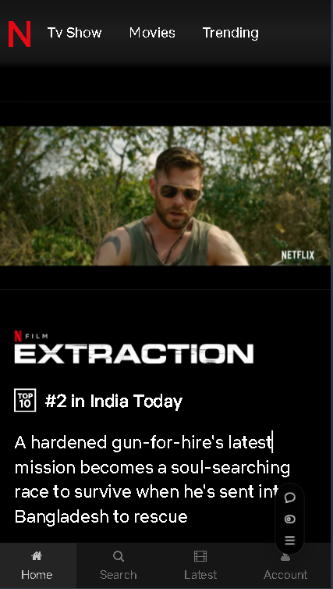
Conclusion
Responsive Design
Successful Replication of Netflix Interface
Achieved full responsiveness, allowing seamless navigation across different devices for a consistent user experience
Successfully recreated the core design and functionality of Netflix
Enhanced Front-End Skills
Portfolio-Worthy Project
Strengthened skills in HTML, CSS, JavaScript, and responsive design principles
Netflix Clone serves as a strong addition to the portfolio
Interactive and Engaging UI
Foundation for Future Enhancements
The dynamic carousels, responsive layout, and hero section with video playback make the application engaging and interactive
Plans for API integration and potential migration to React, the project is well-positioned for future scalability and dynamic content updates

Slide 21
